Slide 1
NSA Naples, Italy Religious Ministries Department

Slide 2
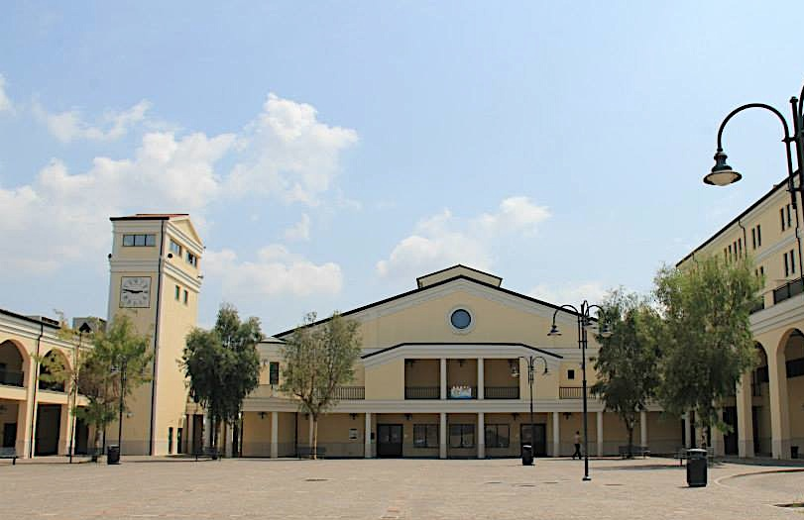
How To Find NSA Naples Religious Ministries Department
SUPPORT SITE CHAPEL
OUR OFFICE IS LOCATED ON THE 1ST DECK IN THE CHAPEL
NAVY LODGE TLA
Support Site Chapel DSN: 629-4964 Capodichino Chapel DSN: 626-3539
Commercial Line: +39-081-811-4964 Commercial Line: +39-081-568-3539
Notes:
Ch Hall – slides 2-3; 7-9

Slide 3
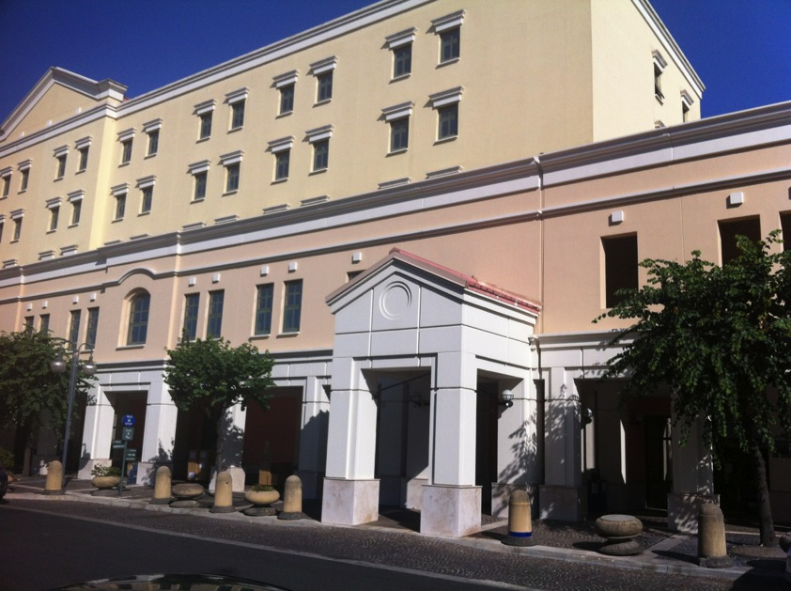
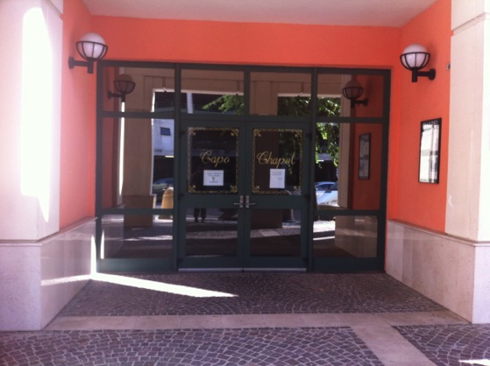
Capodichino Chapel
CAPODICHINO CHAPEL
NAVY GATEWAY
Support Site Chapel DSN: 629-4964 Capodichino Chapel DSN: 626-3539
Commercial Line: +39-081-811-4964 Commercial Line: +39-081-568-3539
Notes:
Ch Hall

Slide 4
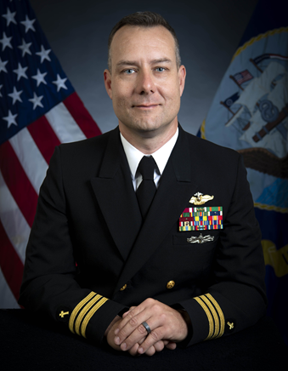
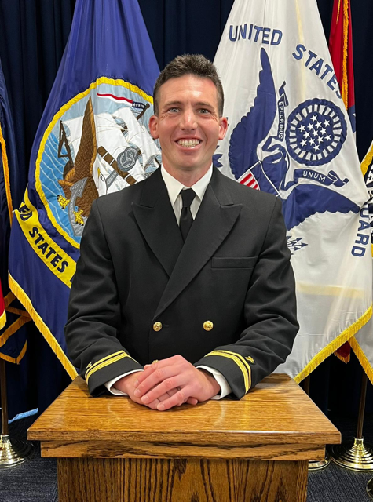
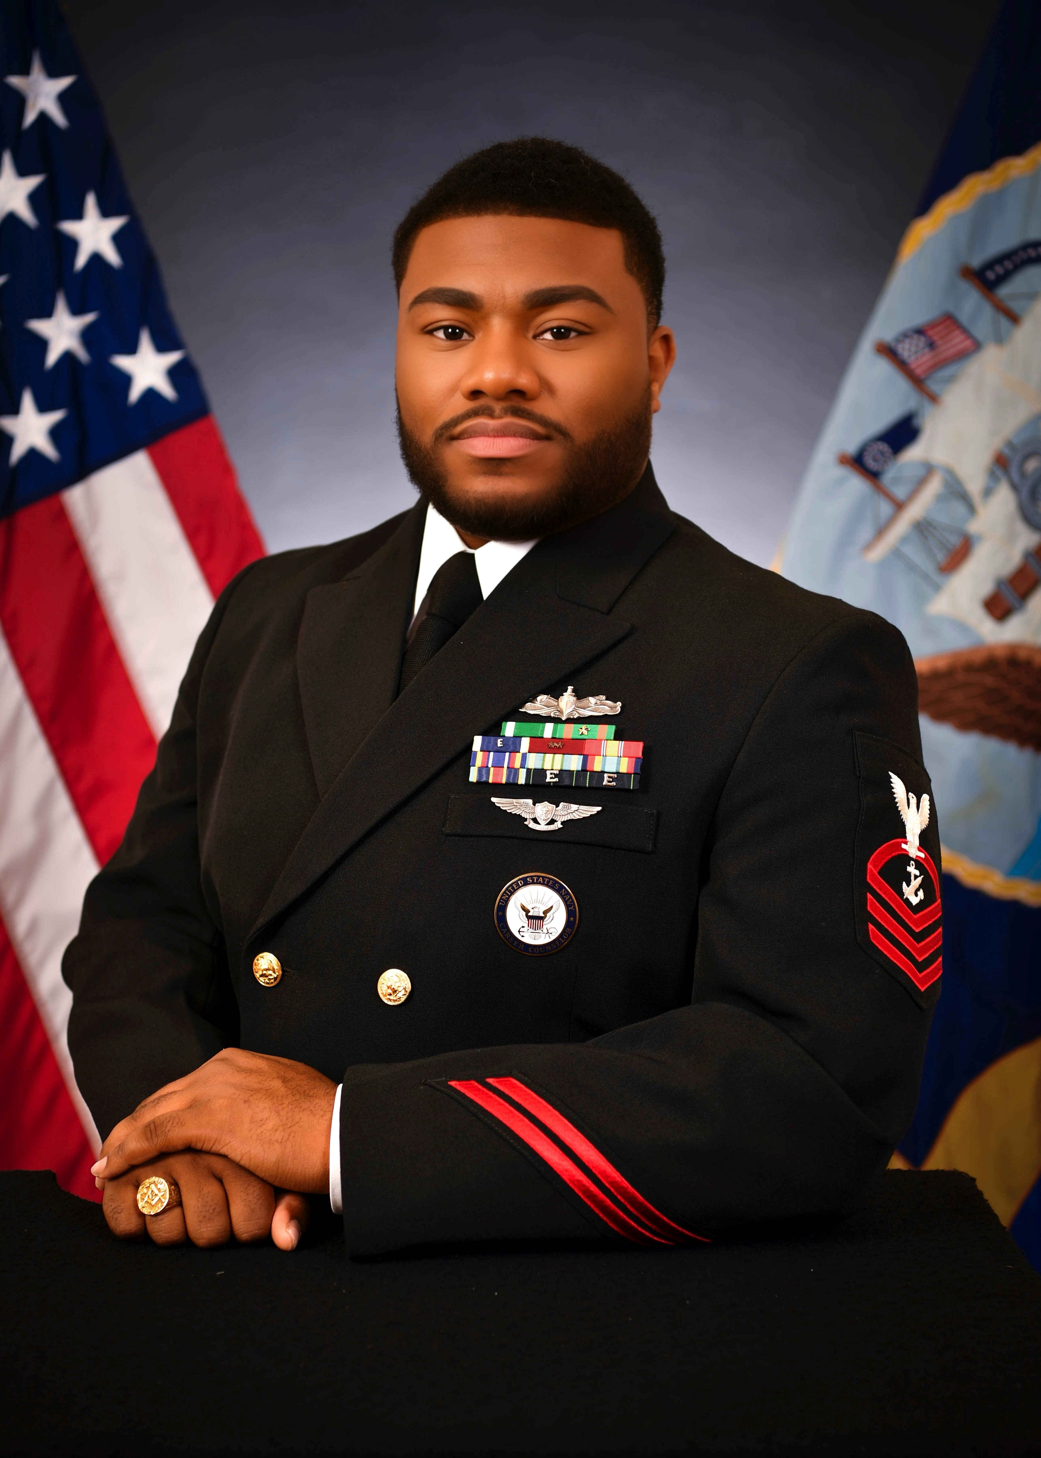
Religious Ministries Department
Chaplains
COMMAND CHAPLAIN, DEPT. HEAD
CDR Matthew Riley
Assembly of God
DIVO
LTJG David Campo
Roman Catholic
DLCPO
NCC Ethridge Rashad
NSA Naples’ CDO: +39-335-825-7986

Slide 5
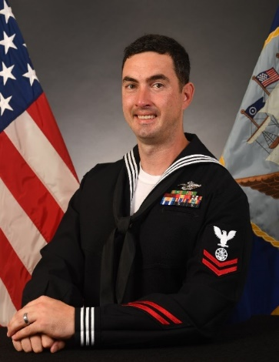
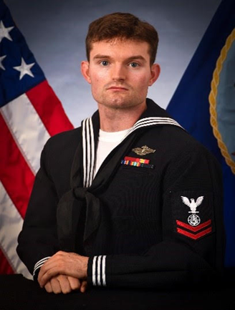
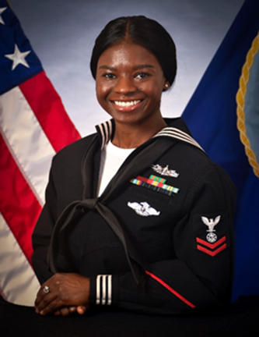
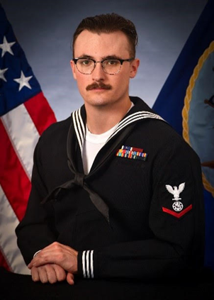
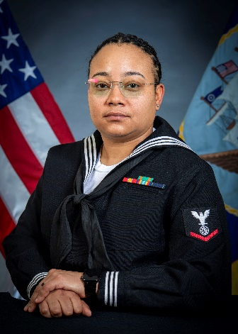
CHAPEL MANAGER, DLPO
RP1 Jozsa , Brandon
ALPO
RP2 Wannen , Charles
RP2 Urguhart, Kestor
RP3 Figueroa, Tyesha

Slide 6
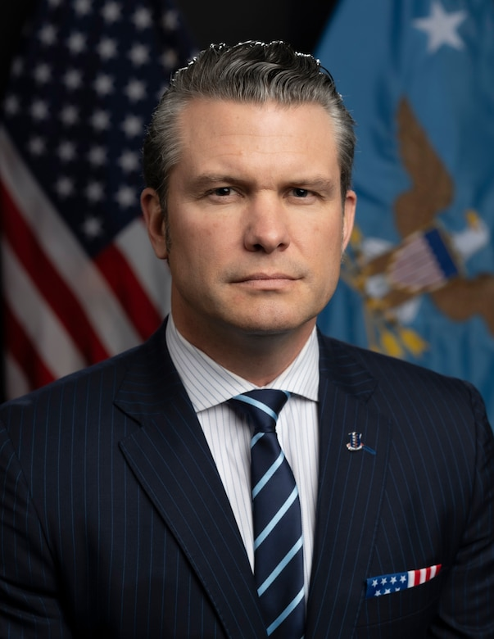
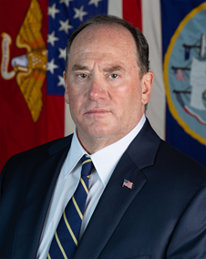
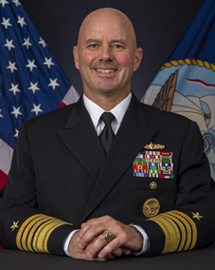
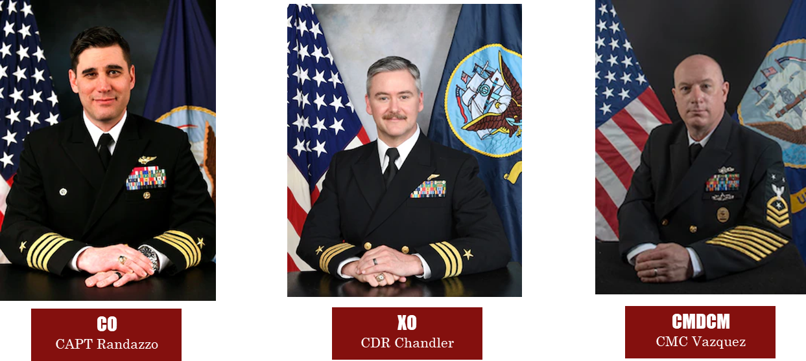
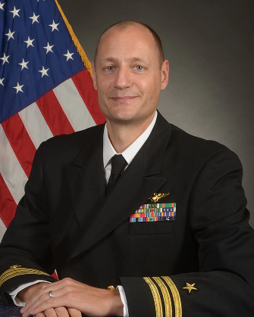
Religious Ministries Department
Chain Of Command
U.S. NAVY / NSA NAPLES
POTUS
Mr. Trump
SECDEF
Mr. Hegseth
XO
CDR Koch

Slide 7
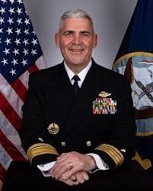
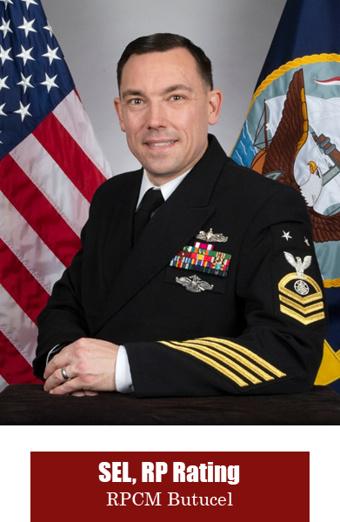
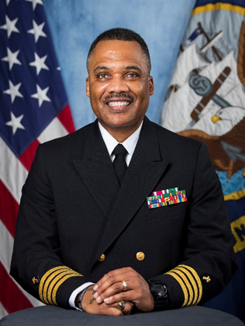
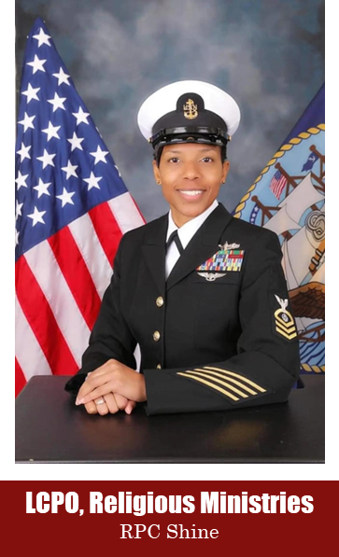
Religious Ministries Department
Chain Of Command
CHAPLAIN CORPS / EURAFCENT
Navy Chief of Chaplains
RADM Todd
RPD, Religious Ministries
CAPT Dance

Slide 8
Area Wide
Chaplains & Religious Program Specialists (RP)
CNE-CNA-C6F Chaplain
DSN 626-5956
CAPT Solomon
RPC Cooper
USS Mount Whitney (LCC 20)
DSN 626-9000 ext. 7816/2428
LCDR Hickman
RP1 Ferguson
Navy Region EURAFCENT
DSN 626-4307
CAPT Dance
RPC Shine
US Naval Hospital
DSN 629-6450
LCDR Folahan
RP2 Reyes
CREDO
DSN 626-5255
CDR Benton
RP1 Cole
RP3 Rodrigez
AF South Battalion
DSN: 646-6007
CPT Coats
SGT Stewart
Notes:
Ch Hall

Slide 9
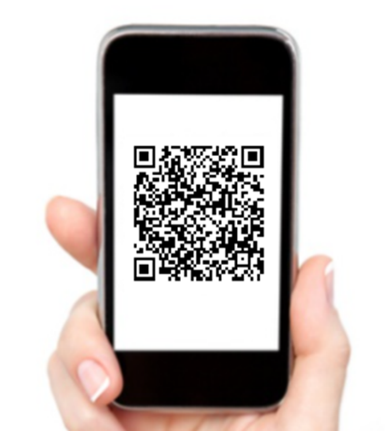
NAPLES
EMERGENCY NUMBERS AND HOTLINES
Emergency Calls On Base: 911
Off Base: 081-568-4911
Information: 113
Fraud/Waste and Abuse: 626-2983
Family Advocacy: 629-6533
Sexual Assault Response: 335-640-6621
CNREURAFCENT
CHAPELS
Please scan the QR Code

Slide 10
Confidential Counseling
POLICY: SECNAVINST 1730.9
Chaplains, Contract Priests, Religious Program Specialists (RPs), or Chaplain Assistants (CAs) will protect confidential communications as part of their professional duties… Only the counselee may release the Chaplain, RP, or CAs from confidentiality.
Notes:
Ch Hall

Slide 11
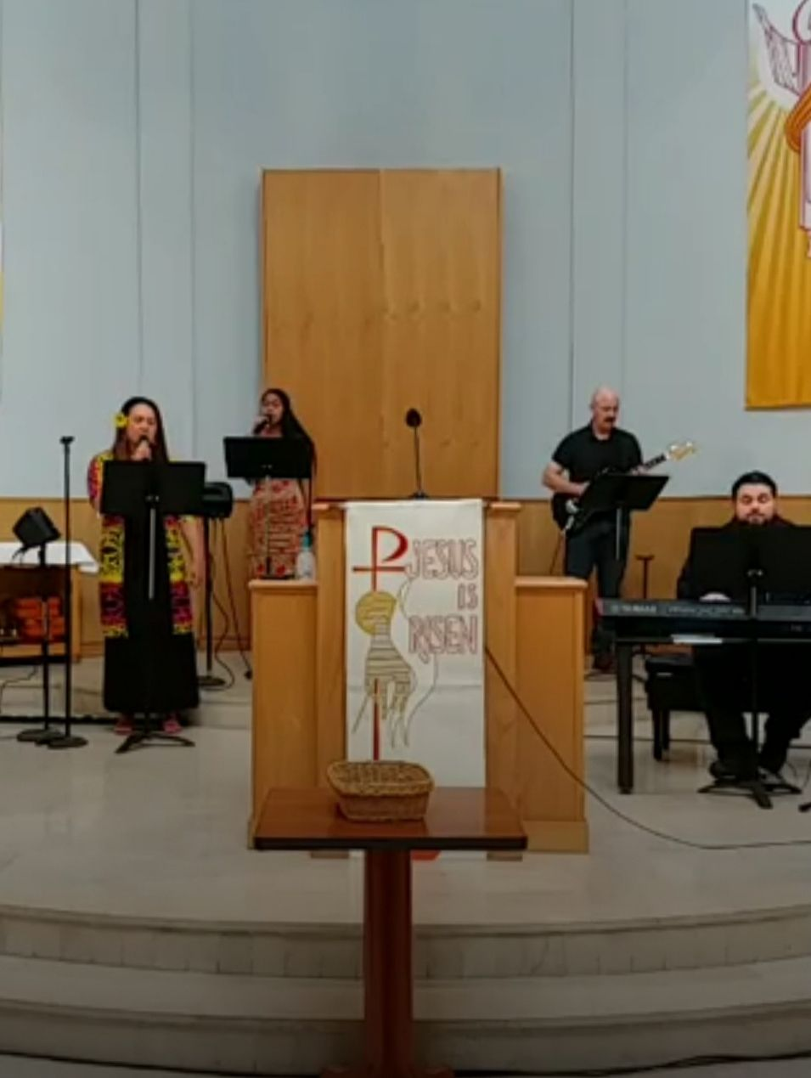
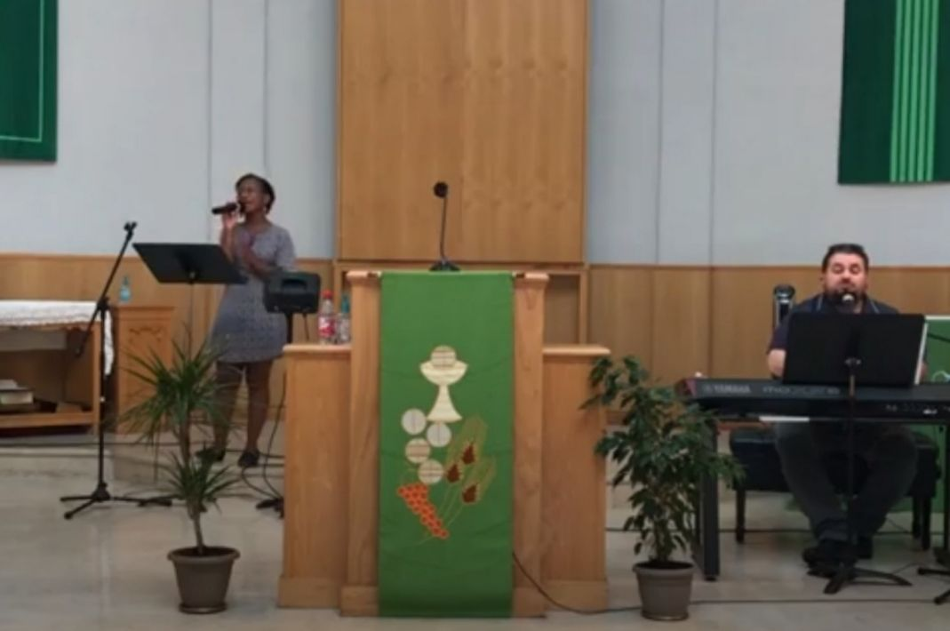
Protestant Worship
Support Site Chapel Sunday @ 0930
Notes:
11
Ch Foshee / Kim

Slide 12
Roman Catholic
Weekend Mass
Saturday – Support Site
Confessions @ 1600
Vigil Mass @ 1700
Sunday – Support Site
Confession @ 1045
Mass @ 1130
Confession/Adoration Schedule
30 min bf every daily Mass or by appt.
Weekday Mass
Tuesday – Capo @ 1200
Wednesday – Support Site @ 0830
Thursday – Capo @ 1200
Friday – Hospital @ 1200
Notes:
Ch Tiongson or Foshee

Slide 13
Lay-Led Services
The Jewish Community
Lay Leader: Megan Steinbergs
Jewishcommunitynsanaples@gmail.com

Slide 14
Chapel Community Programs
Knights of Columbus
KofCNaples@gmail.com
Protestant Women of the Chapel
PWOCNaplesItaly@gmail.com
Catholic Women of the Chapel naplescwoc@gmail.com
Notes:
RPSN Lucas

